Slide 1
Title : SHARC Hardware Introduction & Connection, About BSP of ADSP21593 hardware
20 Feb 2025

Slide 2
AGENDA
Hardware connections
MELODY-9 hardware
MELODY-8 hardware
EV-SOMCRR-EZKIT hardware
Introduction about BSP(Board Support Package) for ADSP-21593
Blackfin, FPGA, GUI Communication
Loading Procedures
Flashing Procedures
Symbols Loading

Slide 3
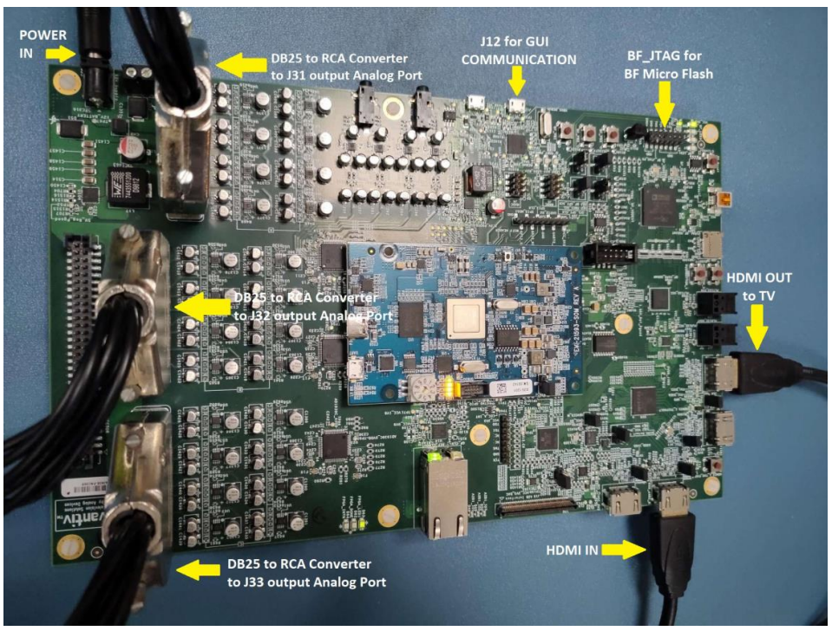
ADSP-21593(Eval Melody-9) Hardware & Connections
A carrier board also known as base board provides the necessary connectors, interfaces and power routing to support SOM.​
Carrier board acts as the primary interface and connection platform for the SOM board.

Slide 4
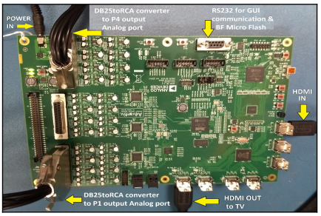
ADSP-21569(Eval Melody-8) Hardware & Connections
Melody-8 hardware has carrier board with all required peripherals, external memory DDR and flashing chip in a single board.

Slide 5
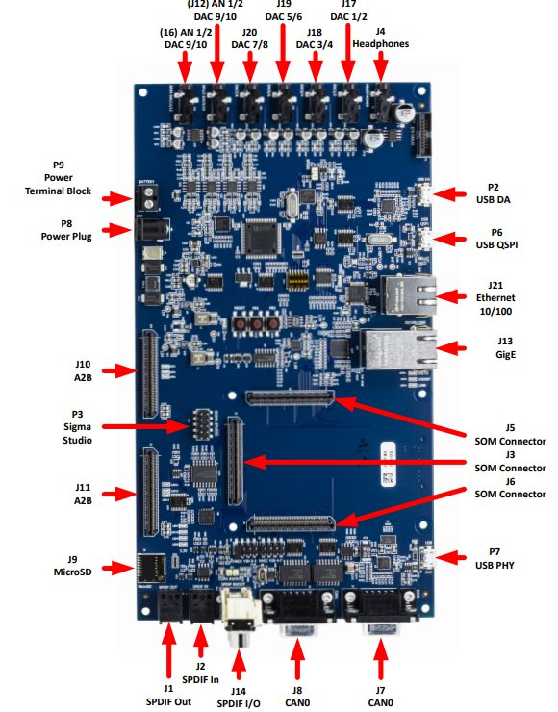
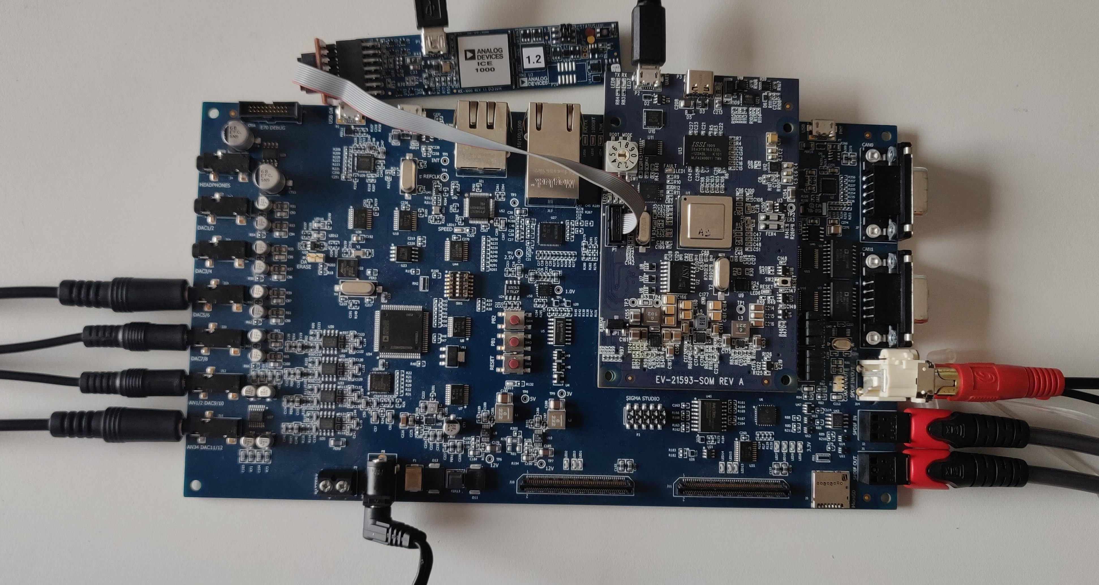
EV-SOMCRR-EZKIT(ADSP-21593) Hardware & Connections
SOM Board : Flash chip is a non-volatile memory that stores and retains data even when power is turned off and when power-up, DSP can quickly load and execute stored code.
Dual SHARC+ Cores
Provides 12 DAC channels.

Slide 6
BSP for ADSP21593
A Board Support Package(BSP) is a collection of drivers, configuration files and documentation that are in support of the hardware platform.
The EV-SC59x EZ-KIT BSP provides comprehensive software support for the EV-SC59x EZKIT(ADSP-21593, ADSP-SC594, ADSP-SC598)
In BSP, various examples are provided to demonstrate the on-chip drivers and services.
Initialization and configuration of peripherals like GPIO, SPI, I2C, UART, ADC/DAC are provided in the package.
Detailed guides and references for getting started with the BSP on specific hardware is available.

Slide 7
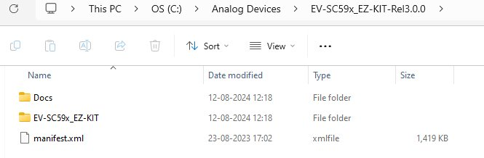
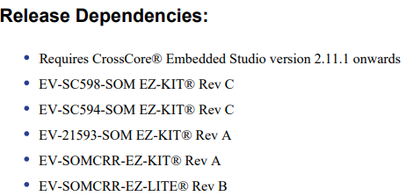
BSP for ADSP21593
After installation of EV-SC59x EZ-KIT BSP package, it is available in Analog Devices folder in installation path.
In Docs folder, release notes provides information on the processors applicable and CrossCore Embedded Studio(cces) version to be used.

Slide 8
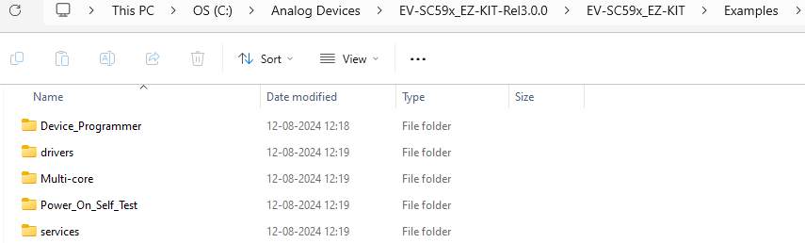
BSP for ADSP21593
In EV-SC59x EZ-KIT Examples folder, Power_On_Self_Test example allows the user to test many peripherals. Readme is provided in the POST example to understand how these tests are run.
Various device driver and system service examples are provided in drivers and services folder.
Multi-Core examples are provided to demonstrates inter-core handshake using system software interrupts and TRU interrupts.
Device_Programmer example allows the user to program the flash device on the EV-SC59x EZ-KIT in conjunction with the "Command-Line Device Programmer (cldp)".

Slide 9
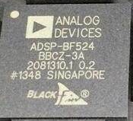
Blackfin
BF524 is a Blackfin DSP processor, and it is used as host controller in EVAL-MELODY9.
The BF524 processor configures the ADSP-21593 DSP with default configuration parameters, and it also provides an interface to PC through the serial port through which users can send command to ADSP-21593 DSP and receive the status from the ADSP-21593 DSP.
FPGA
FPGA on EVAL-MELODY-9 provides a flexible interface between DAI pins of the ADSP-21593 DSP.

Slide 10
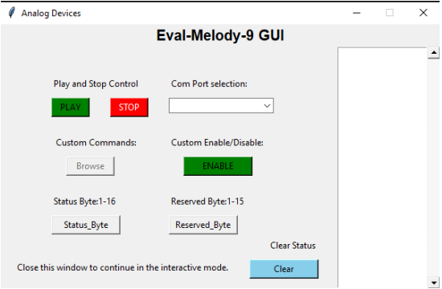
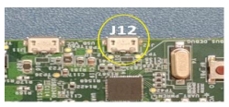
GUI Communication
A Graphical User Interface(GUI) is a user interface that allows to interact with devices through graphical elements like icons, buttons, menus and text-based commands.
UART cable is connected to ‘J12’ of EVAL-MELODY-9 board and run GUI for sending commands

Slide 11
LOADING & FLASHING
Procedures through emulator

Slide 12

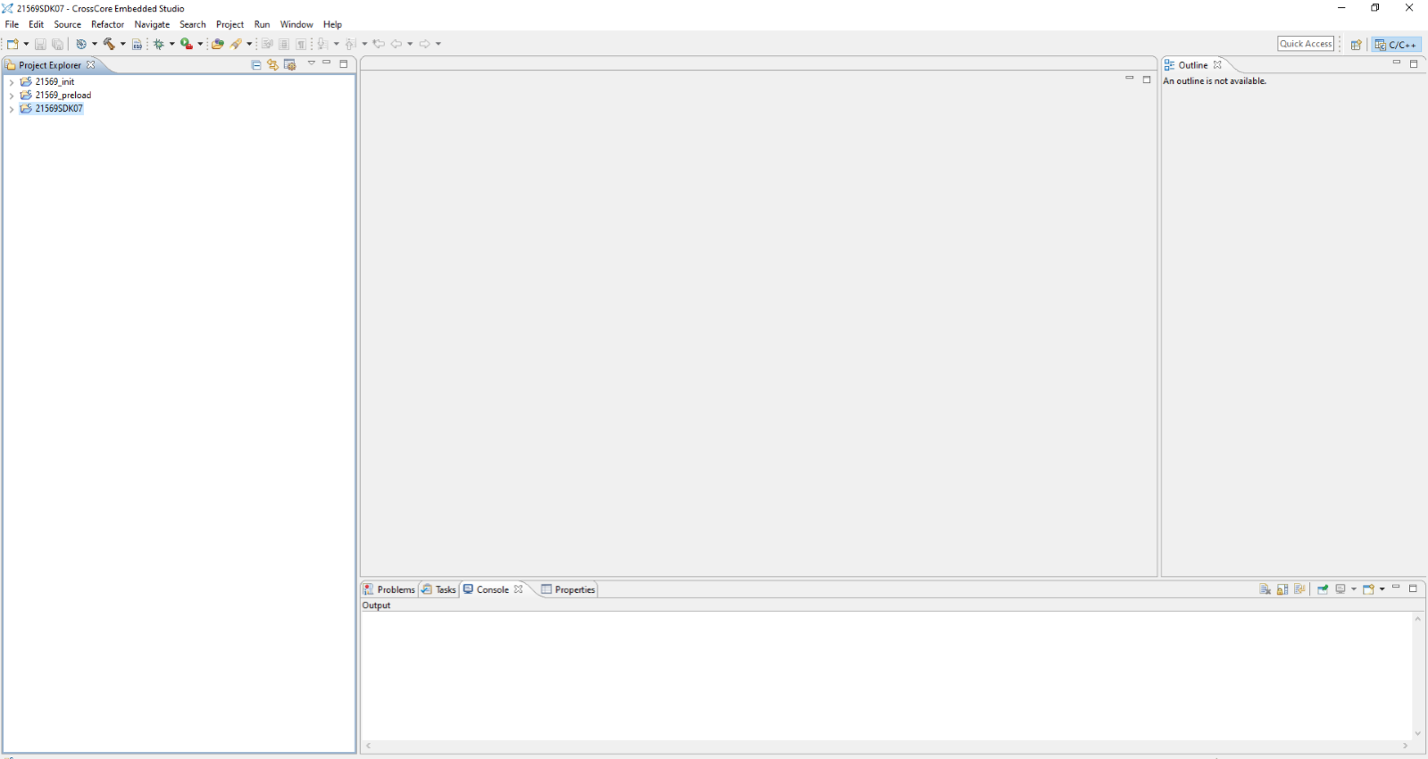
ADSP-21569(Melody-8) hardware - Loading
The file directory structure will be as shown below
Lunch in CCES 2.9.1
From the main menu, follow File -> Import -> General -> Existing Projects into Workspace -> Next -> Select Root Directory -> Finish. The picture shown below is the screen after projects are imported successful

Slide 13
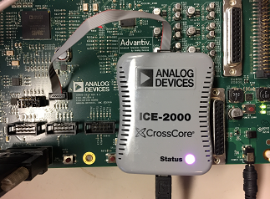
select Project -> Build All (or right click on each project and select build option to build each project if the change is localized to a specific project) and wait until the build is completed.
Connect ICE-2000 emulator
Run -> Debug Configurations -> Right click on Application with Cross Core Debugger -> New -> SHARC, ADSP-21569 -> Next -> Emulator -> ADSP21569 via ICE-2000 -> Finish.

Slide 14
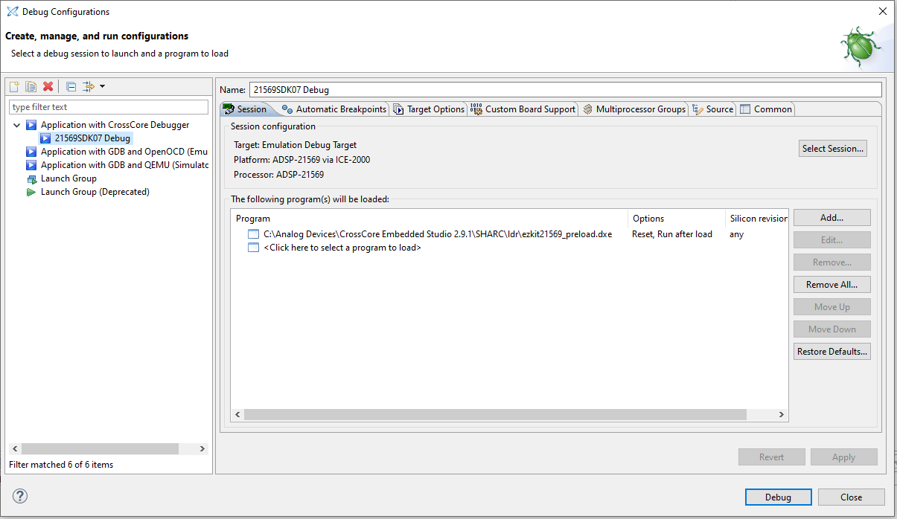
The picture shown below is the screen after Debug Configuration is created successfully.
Remove the default Preloader and add “21569_preload.dxe” from 21569_preload source folder.

Slide 15
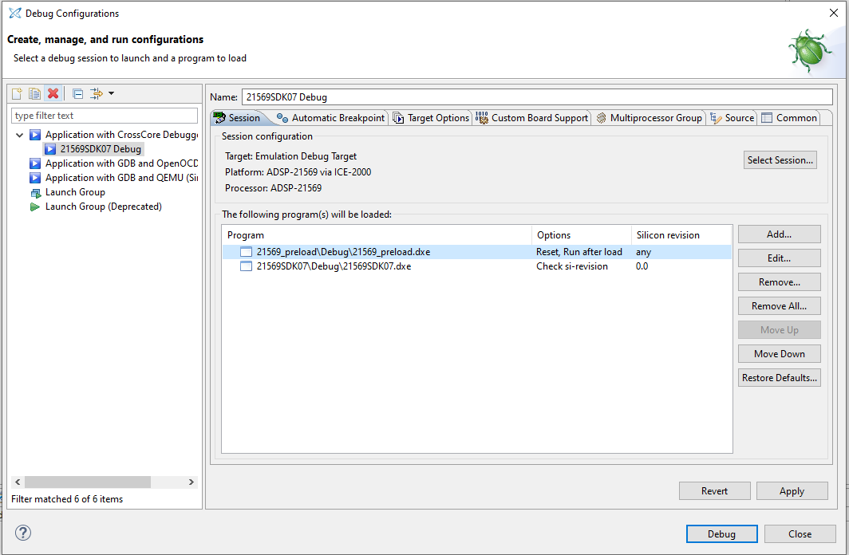
Add one more file using the same method., File: 21569SDK07\21569SDK07\Debug\ 21569SDK07.dxe

Slide 16
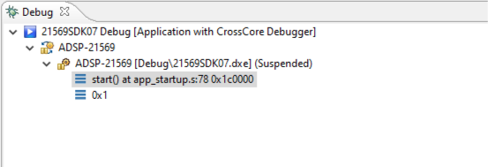
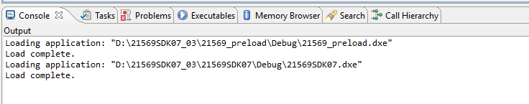
Click the Apply button to save the settings.
From the main menu, select Window -> Preference -> Run/Debug -> Uncheck “Build (if required) before launching) if you don’t want to build the code again.
Hit the Resume button as shown below to start.
Hit the Debug button.

Slide 17

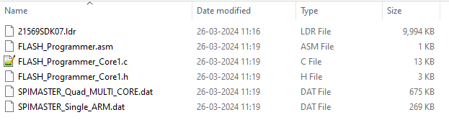
ADSP-21569(Melody-8) hardware - Flashing
The file directory structure will be as shown below
Copy the Loader file from the Flashables folder to FLASH_Programmer_Core project “src” folder
Import “FLASH_Programmer_Core” project to the CCES workspace (CCESv2.9.1 build w1909051) and build the project.
Load the code using the “debug Configuration” option.

Slide 18
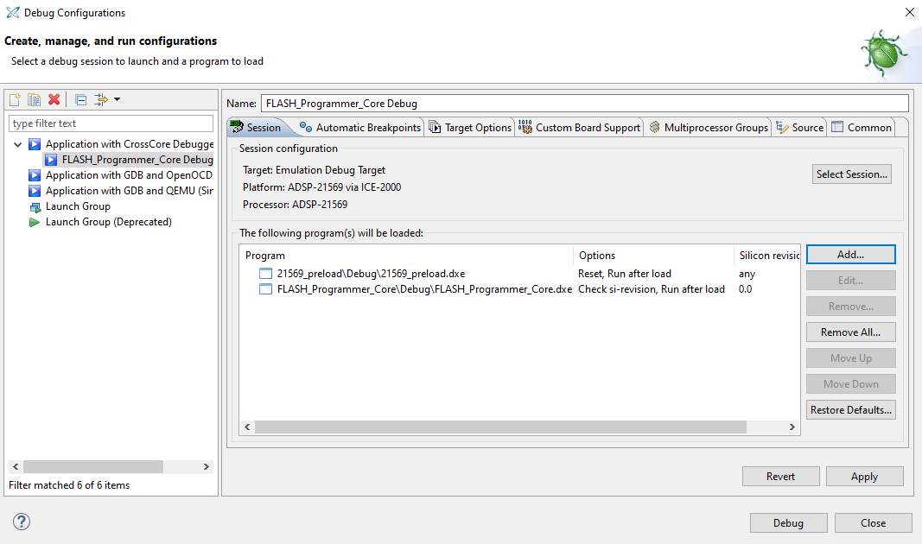
Select the processor as “ADSP21569” and ICE2000.
Select the executables “21569_preload.dxe” & “FLASH_Programmer_Core.dxe” from the respective folder.

Slide 19
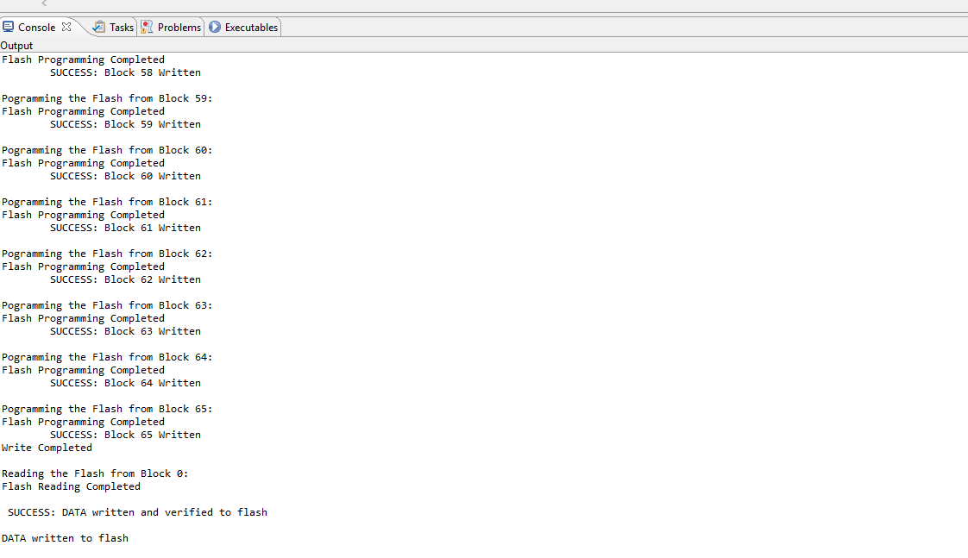

Select Apply and Debug., Select “Yes” for code loading message and debug message
After the Load complete, “RESUME” the CCES and check the output window for the Flash writing progress
Make sure the flashing done successfully by the message printed in console window.

Slide 20
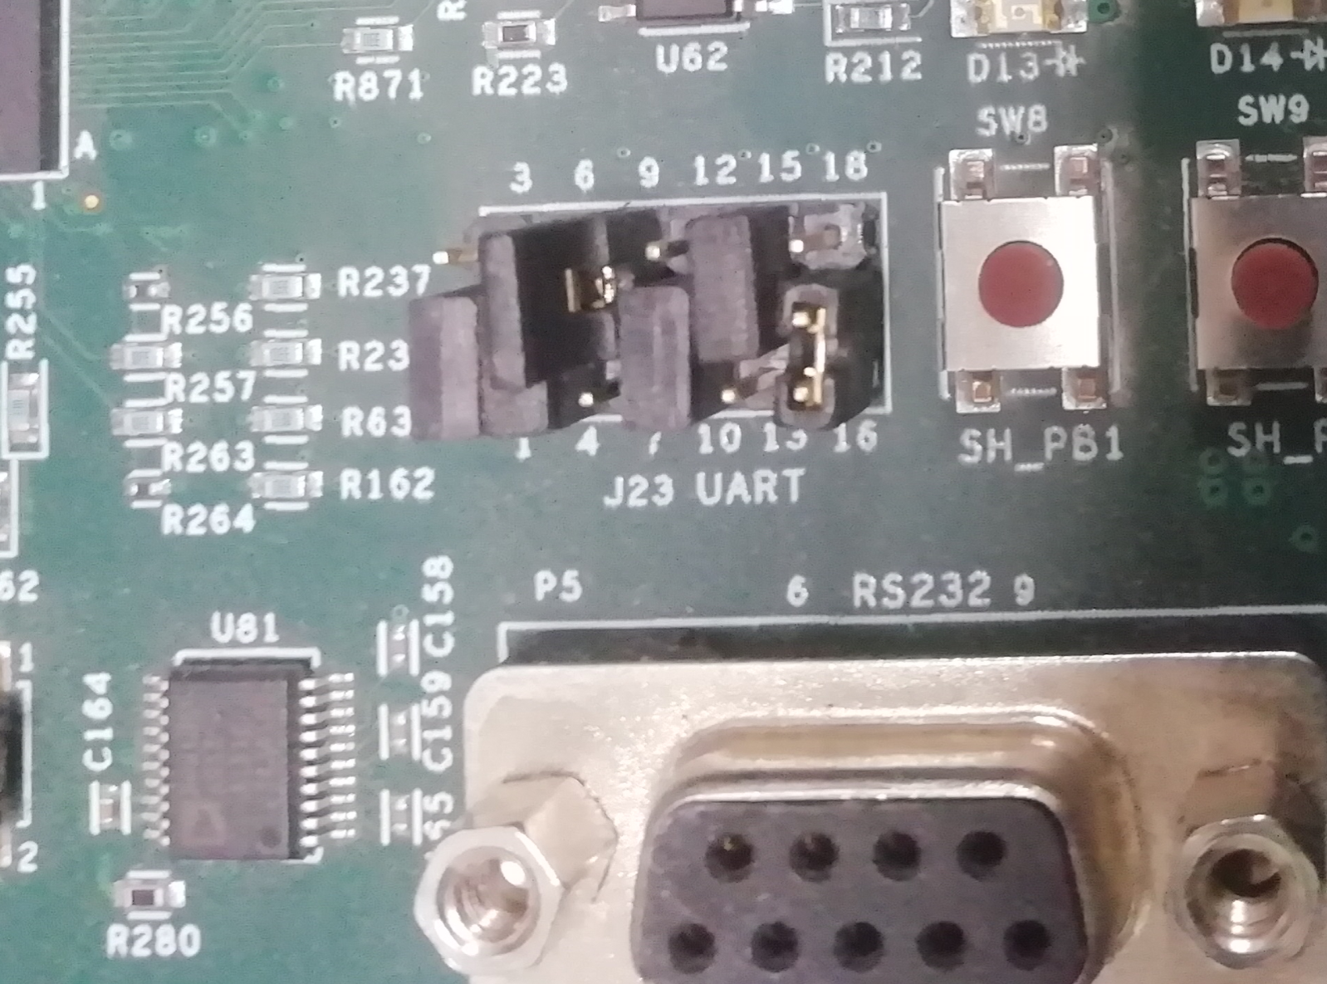

Connect the Jumper between 8 and 9 to J23 port as shown in below image.

Slide 21
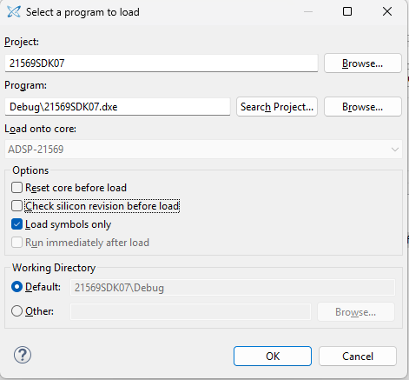
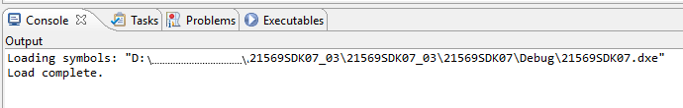
Symbols loading
Take and import the same Flash programming project
Flash the code and after flashing done successfully
Connect the ICE-2000 emulator for loading symbols
Select the " Load symbols only" option to 21569SDK07.dxe
Hit the Debug button

Slide 22






India, Germany, Japan, USA & China
+91 44 6666 9600
www.jasmin-infotech.com
THANK YOU!

